Slide 1
Creating Solution Architecture

Slide 2
A Quick Recap

Slide 3
Architecture : Recapitulation of Three Steps
Define system boundary
Create structure of the solution
Refine the structure to implement the solution
Notes:
test

Slide 4
Architecture : Recapitulation of Three Steps
Define system boundary
  What is the purpose of the system?
  What the system does not do
  What are the external dependencies?
Create structure of the solution
Refine the structure to implement the solution
System Context
Notes:
test

Slide 5
Architecture : Recapitulation of Three Steps
Define system boundary
Create structure of the solution
  How the system will be accessed?
  What are the main conceptual elements?
  How the elements communicate with each other?
Refine the structure to implement the solution
Architecture Overview
Notes:
test

Slide 6
System Context

Slide 7
Architecture : System Context Key Questions
What is the core functionality of the system ?
Who all are the human users of the system?
What kind of interaction do they have with the system?
What are the external systems interacting with the current system?
  Online, Batch Processing etc.
What kind of connection do the external systems have?
Notes:
test

Slide 8
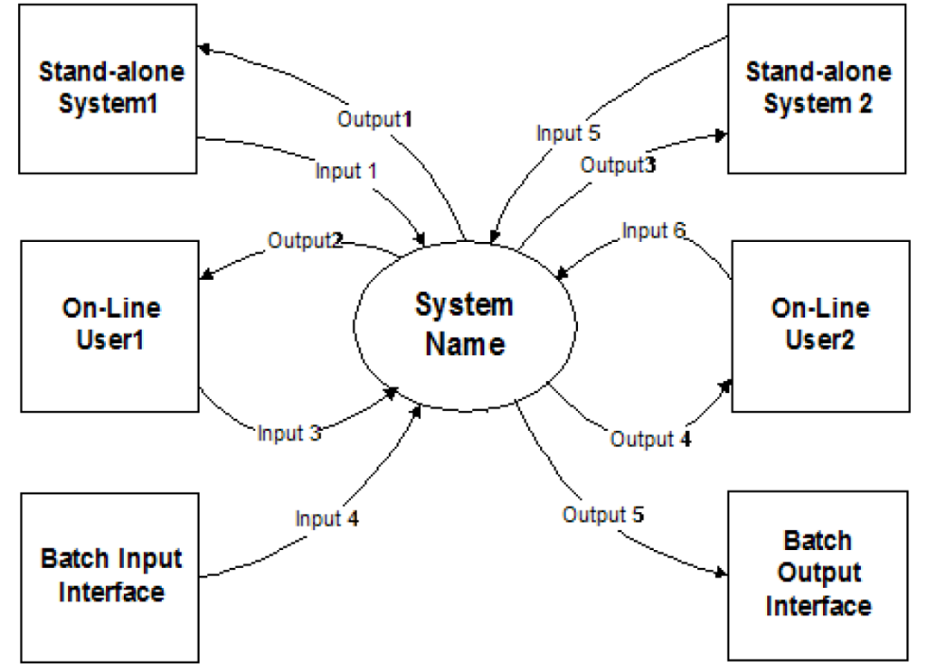
Architecture : System Context Sketch
Notes:
test

Slide 9
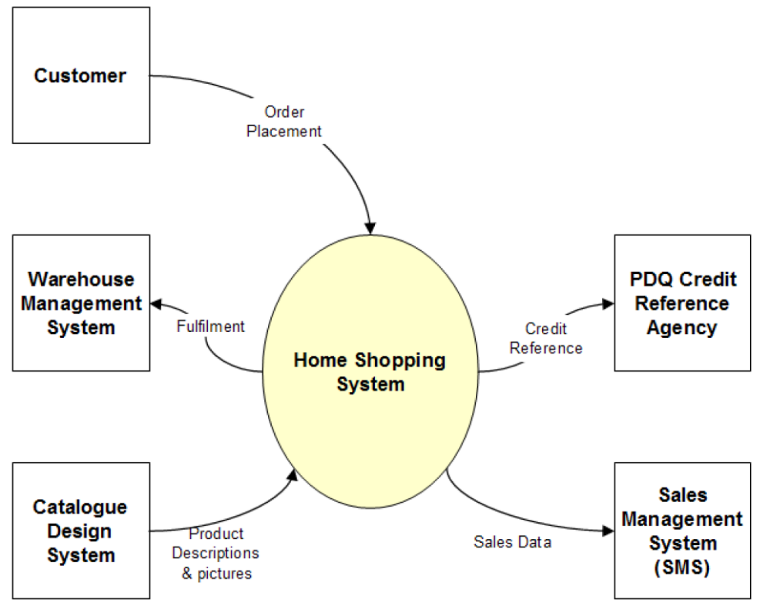
Architecture : System Context Sketch to Concrete
Notes:
test

Slide 10
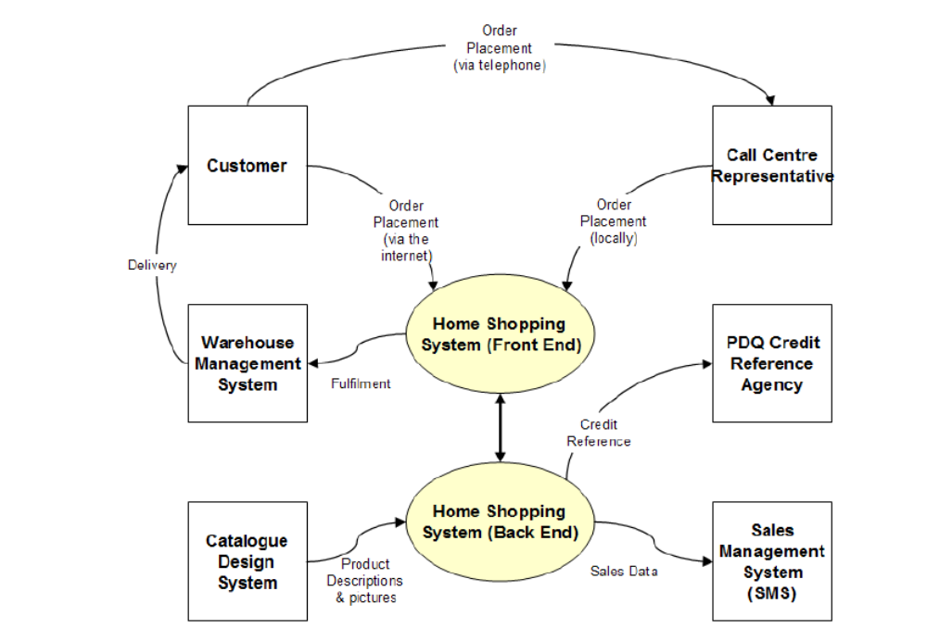
Architecture : We may need Extended System Context sometimes
Notes:
test

Slide 11
Architecture Overview

Slide 12
Architecture : Architecture Overview Key Questions
Who are the users?
What channel do they use to interact with the system?
What are the major components of the system?
  Where do they reside?
Where do the external interfaces reside?
  How do they communicate?
What are the data stores?
  Where do they reside?
Notes:
test

Slide 13
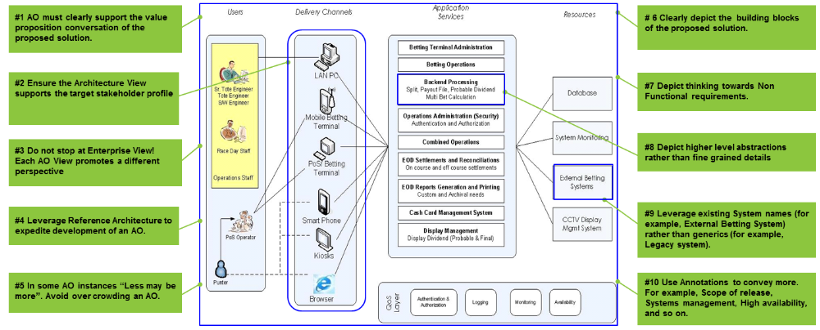
Architecture : Architecture Overview-Preferred Practices
* Reference Architecture https://en.wikipedia.org/wiki/Reference_architecture
Notes:
test

Slide 14
Creating Solution Architecture
Please go through the Case Study (SAD Electronic Voting Case Study.pdf)
Refer to the requirements that you created
Sketch a System Context
Create an Architecture Overview
Notes:
test

Slide 15
Backup

Slide 16
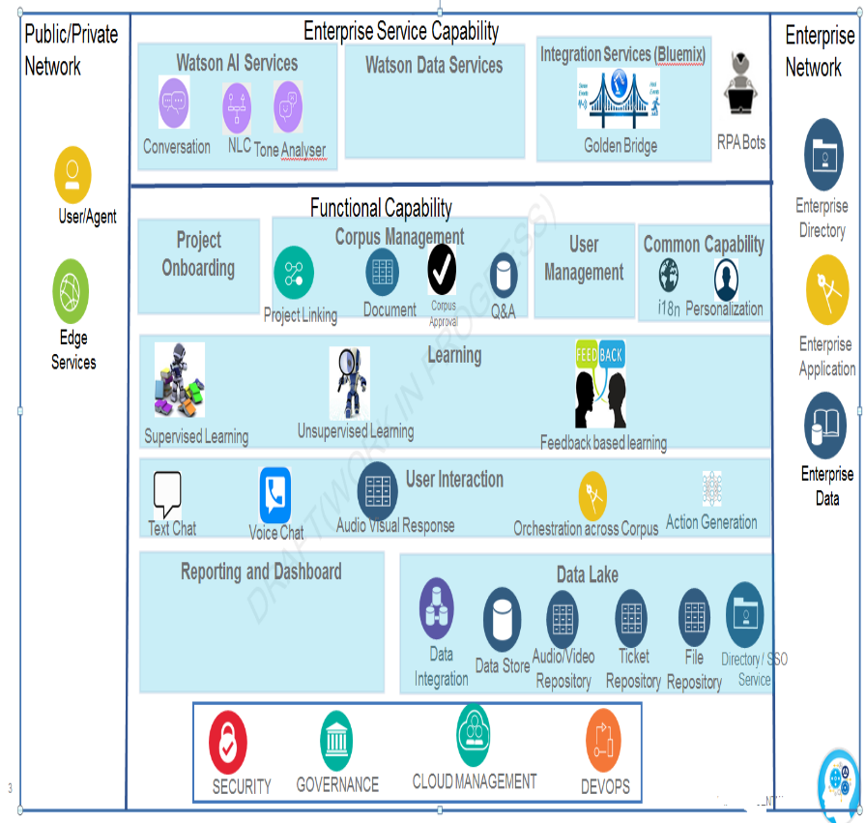
Architecture : Structure of The Solution is Represented using Architecture Overview*
Informal diagram with supporting texts
  Range of different channels to access the system
  Three tier or four tier or more
  Distributed servers and workstations (why?)
  Access to legacy systems
Usually static in nature
  Dynamism may be built in for explanation
Alternative diagrams may be produced
  Enables stakeholders to discuss trade offs between options
* We have shown some examples in the lecture material
Notes:
test

